Slide 1
IST687 – Applied Data Science
Writing Functions

Slide 2
Data Science
R functions
Function from previous chapters
Mean is an example (used on a vector)
Format
Function name: mean
Argument/Input to function: any vector
Function mean returns the mean value of that vector
Bundle of code that can be used over again without retyping

Slide 3
Data Science
R functions
MyMode
MyMode <- function(myVector) # create function MyMode
{
return(myVector)
}
Input argument
Function name
Curly brackets contain function code
{ }
Send back result of function

Slide 4
Data Science
> tinyData <- c(1,2,1,2,3,3,3,4,5,4,5) # create vector tinyData
> tinyData # display content of tinyData
[1] 1 2 1 2 3 3 3 4 5 4 5
> MyMode(tinyData) #pass argument tinyData to function MyMode
[1] 1 2 1 2 3 3 3 4 5 4 5 # MyMode function designed to display content of argument passed to it

Slide 5
Data Science
MyMode <- function(myVector)
{
uniqueValues <- unique(myVector)
return(uniqueValues)
}
# add unique function to MyMode
Note: return argument uniqueVaues
> MyMode(tinyData)
[1] 1 2 3 4 5
# execute MyMode with new unique function. Unique took out redundancies from tinyData vector passed to it

Slide 6
Data Science
MyMode <- function(myVector)
{
uniqueValues <- unique(myVector)
uniqueCounts <- tabulate(myVector)
return(uniqueCounts)
}
# add tabulate function to MyMode
Note: uniqueCounts is being returned
> MyMode(tinyData)
[1] 2 2 3 2 2
# MyMode returns count of how many times each unique value of tinyData occurs

Slide 7
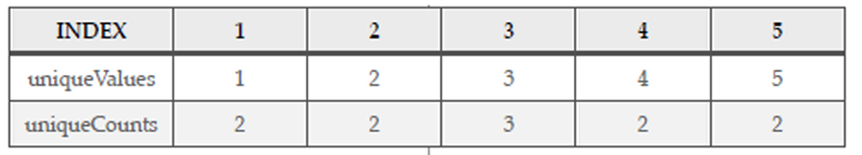
Data Science
Most frequently occurring item is largest number in this row

Slide 8
Data Science
MyMode <- function(myVector)
{
uniqueValues <- unique(myVector)
uniqueCounts <- tabulate(myVector)
return(uniqueValues[which.max(uniqueCounts)])
}
# add which.max code
# return the uniqueValue that has the highest uniqueCount associated with it
> tinyData
[1] 1 2 1 2 3 3 3 4 5 4 5
> MyMode(tinyData)
[1] 3
# display content of tinyData
# execute MyMode
uniqueValue that has the highest uniqueCount associated with it

Slide 9
Data Science
> tinyData<-c(tinyData,5,5,5)
> tinyData
[1] 1 2 1 2 3 3 3 4 5 4 5 5 5 5
> MyMode(tinyData)
[1] 5
# add additional values to tinyData
# display content of tinyData
uniqueValue that has the highest uniqueCount associated with it
>tinyData<-c(tinyData,1,1,1)
> tinyData
[1] 1 2 1 2 3 3 3 4 5 4 5 5 5 5 1 1 1
> MyMode(tinyData)
[1] 1
# add additional values to tinyData
# display content of tinyData
uniqueValue that has the highest uniqueCount associated with it

Slide 10
Data Science
tinyData<-c(tinyData,1,1,1)
> tinyData
[1] 1 2 1 2 3 3 3 4 5 4 5 5 5 5 1 1 1
> MyMode(tinyData)
[1] 1
# add additional values to tinyData
# display content of tinyData
uniqueValue that has the highest uniqueCount associated with it
Issue:
tinyData contains 5 1’s and 5 5’s however our MyMode function is only returning 1 as the uniqueValue with the highest uniqueCount associated with it
which.max returns the first maximum it finds
We’ll see a solution to this toward the end of our discussion, stay tuned

Slide 11
Data Science
> tinyData<-c(tinyData,9,9,9,9,9,9,9)
> MyMode(tinyData)
[1] NA
> tabulate(tinyData)
[1] 5 2 3 2 5 0 0 0 7
# add additional values to tinyData
# execute MyMode
# ???????????
# tabulate returns count of how many times each unique value of tinyData occurs. Note 0’s for 6, 7, 8 that were not present
What’s causing the issue?

Slide 12
Data Science
> tinyData<-c(tinyData,9,9,9,9,9,9,9)
> MyMode(tinyData)
[1] NA
> tabulate(tinyData)
[1] 5 2 3 2 5 0 0 0 7
# add additional values to tinyData
# execute MyMode
# ???????????
# tabulate returns count of how many times each unique value of tinyData occurs. Note 0’s for 6, 7, 8 that were not present
> unique(tinyData)
[1] 1 2 3 4 5 9
# unique returns the 6 unique values in tinyData. It does not match the number of elements being returned by tabulate

Slide 13
Data Science
MyMode <- function(myVector)
{
uniqueValues <- unique(myVector)
uniqueCounts <- tabulate( match(myVector,uniqueValues))
return(uniqueValues[which.max(uniqueCounts)])
}
Add new code to ‘tabulate’ such that instead of tabulating every possible value in tinyData, including the ones for which there is no data, only tabulate those items where there is a match between the list of unique values and what is in myVector
> MyMode(tinyData)
[1] 9

Slide 14
Data Science
Observations
Iterative nature of custom function development via RStudio (script & console windows)
New functions introduced
Recommend community sourcing
Find & install an existing R package (ie modeest)
“package” tab in RStudio window
Install package option
Search & install with dependencies
Check box to execute “library” function

Slide 15
Data Science
> mfv(tinyData)
[1] 9
# mfv – most frequent value
> multiData <- c(1,5,7,7,9,9,10)
> mfv(multiData)
[1] 7 9
> MyMode(multiData)
[1] 7
# create vector and assign to multiData
# note 2 7’s and 2 9’s
# mfv accurately displays 7 & 9
# our custom MyMode function only displays 7

Slide 16
IST687 – Applied Data Science
Chapter 9
Beer, Farms, and Peas

Slide 17
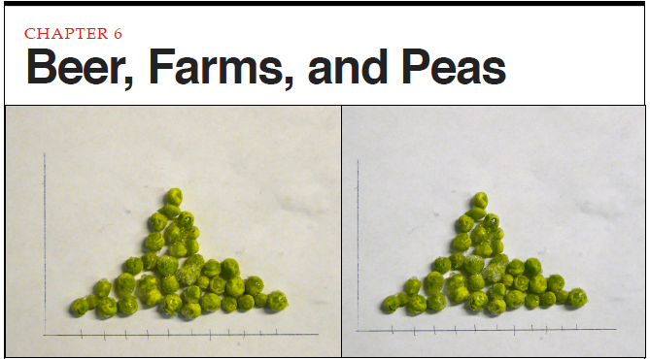
Data Science
Many of the simplest and most practical methods for summarizing collections of numbers come to us from four guys who were born in the 1800s at the start of the industrial revolution. A considerable amount of work they did was focused on solving real world problems in manufacturing and agriculture by using data to describe and draw inferences from what they observed.

Slide 18
Data Science
Chapter Objectives
Review of contributions by early statistical pioneers
Discussion, examples, and exercise utilizing descriptive statistic functions
mean
median
range
mode
variance
standard deviation
Measures of Central Tendency and Dispersion
Frequency distribution models and interpretation

Slide 19
Data Science
Some History: Contributions to the Statistical Party
Francis Galton: eugenics & peas
Karl Pearson: correlation & regression
William Sealy Gosset: small sample statistical techniques & beer
Ronald Fisher: analysis of variance & farms

Slide 20
Data Science
Pervasive tenet: “sample of data”
Whatever data you have there is more out there
Whatever data you have, it’s just a snapshot or sample of what might be out there
There is always uncertainty in data & we need to guard against putting too much stock in what a sample of data has to say

Slide 21
Data Science
Descriptive vs. Inferential Statistics
Descriptive statistics covered previously
Mean
Median
Range
Mode
New to this discussion
Variance
Standard Deviation

Slide 22
Data Science
Measure of Central Tendency
Mean
Median
Measure of Dispersion
Range
Variance
Mode
Standard Deviation

Slide 23
Data Science
Residential population dataset
State
Population value
Loaded into “R”
USstatePops$april10census
.Alaska | 710,231
.Arizona | 6,392,017
.Arkansas | 2,915,918
.California | 37,253,956
.Colorado | 5,029,196
.Connecticut | 3,574,097
.Delaware | 897,934
.District of Columbia | 601,723
.Florida | 18,801,310
.Georgia | 9,687,653
.Hawaii | 1,360,301
.Idaho | 1,567,582
.Illinois | 12,830,632
.Indiana | 6,483,802
.Iowa | 3,046,355

Slide 24
Data Science
“R” statistical functions using USstatePops$april10census
> mean(USstatePops$april10census)
[1] 6053834
> median(USstatePops$april10census)
[1] 4339367
> mode(USstatePops$april10census)
[1] "numeric”

Slide 25
Data Science
Histogram
A picture that shows central tendency and dispersion
Hist(USstatePops$april10census)

Slide 26
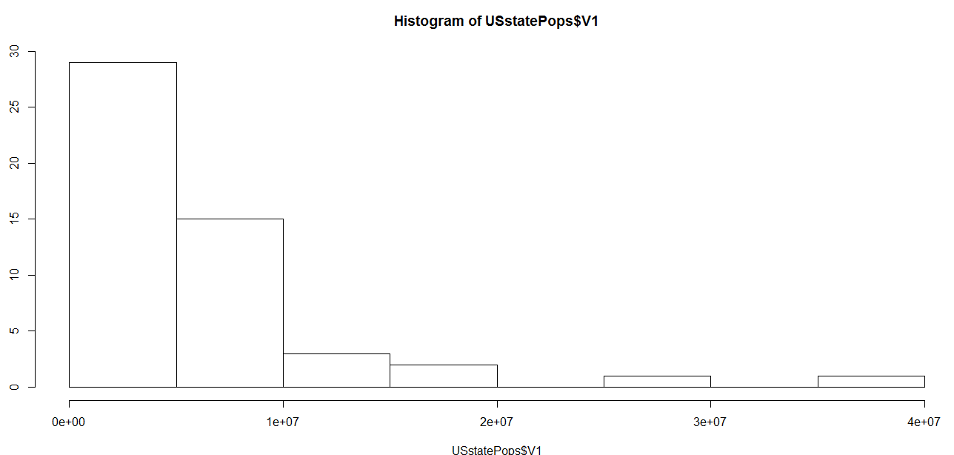
Data Science
Histogram: hist(USstatePops$april10census)

Slide 27
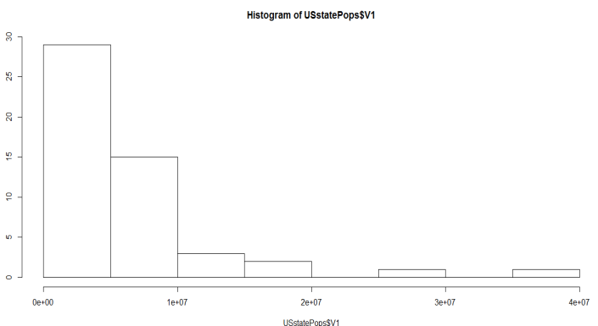
Data Science
hist(USstatePops$april10census)
Designed to show frequencies
Interpretation
X & Y axis
2 bars per tick mark
30 states with populations under 5 million
Another 10 states with population under 10 million
Small number of states with populations greater than 10 million
Observation: 40 states clustered into the first couple of bars

Slide 28
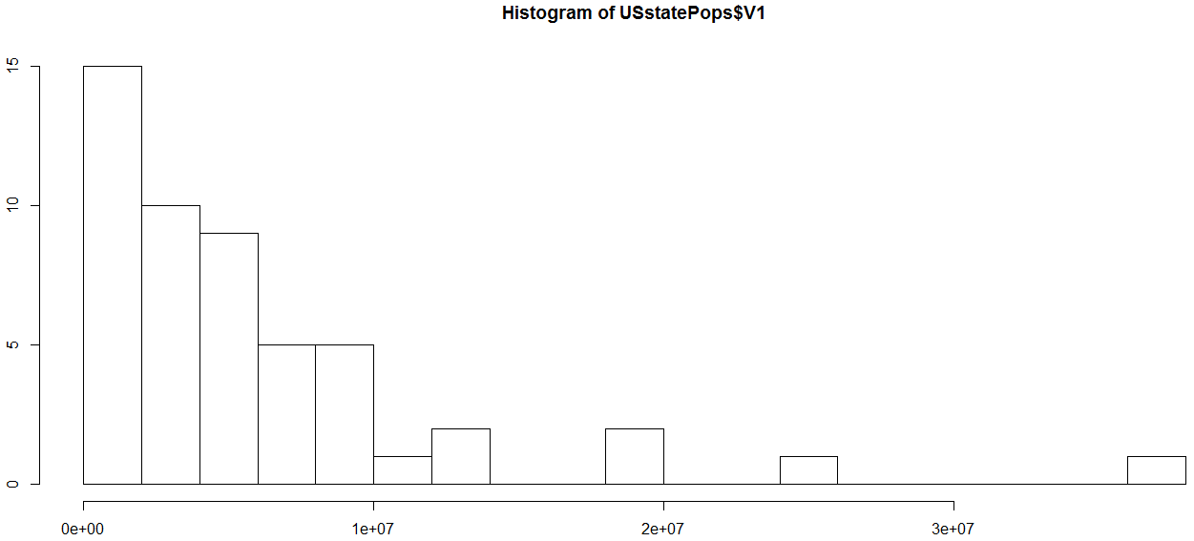
Data Science
hist(USstatePops$april10census, breaks=20)

Slide 29

Data Science
hist(USstatePops$april10census, breaks=20)
Designed to show more bars
Interpretation
5 bars per tick mark
15 states with populations under 2 million
Distribution pattern
Reverse-j distribution pattern

Slide 30
Data Science
Other distributions shapes
The “bell” or normal distribution
Meant to represent the most typical (normal) distribution
Normal shape is that of a bell

Slide 31
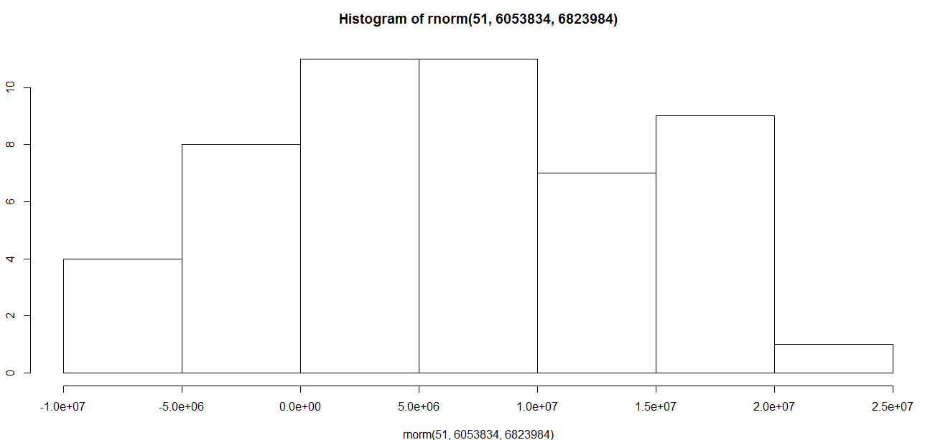
Data Science
Hist(rnorm(51, 6053834, 6823984))

Slide 32
Data Science
“R” components to render the normal distribution of the State population dataset
sd(USstatePops$april10census)
6823984
mean(USstatePops$april10census)
605384
51 data points
hist(rnorm(51, 6043834, 6823984))
Function within a function

Slide 33
Data Science
rnorm(51, 6053834, 6823984)
hist(rnorm(51, 6053834, 6823984)

Slide 34
Data Science
Hist(rnorm(51, 6053834, 6823984))

Slide 35
Data Science
“R” take-aways
Normal distribution is used extensively through applied statistics as a tool for making comparisons
Key pieces of information to enable comparisons
The distribution had a characteristic shape
The distribution had a center point, mean
A “spread” (variability) which was the standard deviation

Slide 36


Data Science
So,,,,
ing the bell for Data Science
More to come in our next segment

Slide 37
IST687 – Applied Data Science
End of Chapter
Beer, Farms, and Peas

